Slide 1
Project Neon – Workshop
wEBSAMPLING
Sept 2025

Slide 2
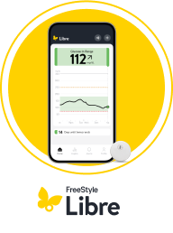
Agenda
Project neon workshop
Day 1 Overview (15 minutes)
Objective
Global Market Insights and Research
Latest Data on Websampling
CURRENT Customer Journey – Project Carbon
NEW Customer Journey – Project Neon
Date | Session | Topics
Day 1 (Monday) | Session 1 | 2:15pm – 3pm: Opt-In Requirements
 | Session 2 | 3 - 4pm: Frequency, Backend Flow, Virtual Forge
Day 2 (Tuesday | Session 3 | 2- 3pm: Opt-Out Requirements
 | Session 4 | 3 – 4pm: Packing Slip Options

Slide 3
Project Carbon: Allow HCPs to re-order web samples via the current website form + open form. HCP needs to continually fill out form & TsCs to get samples.
OVERVIEW OF Project Neon
vs
Project Neon: Allow for friction-less subscription model of samples for HCPs while ensuring we maintain compliant with Legal/OEC.
*HCP Criteria remains the same between Carbon and Neon

Slide 4




Web sampling dashboard as of 9/26
~500M
1,922
18,544
201
Unique HCPs
Reached
Samples
Re-Ordered
HCPs
Enrolled
Samples
Distributed
Reach Goal: Expand Web-sampling to all NCO audience
60M → 500M over 6months
Internal Goal of 10M Sensor Samples!

Slide 5
HCP Web Sampling Research
Global Market Insights
Sept 2025

Slide 6

Web Sampling Research
Objectives & methodology
Methodology and Sample
Methodology
Sample
Quantitative Survey implemented in the Diabetes Wellness Forum HCP Community
10-minute survey
September 3, 2025 – September 8, 2025
A mixture of quantitative and open-end responses to various question types addressing key business questions pertaining to HCPs experience with sample requests
 | CGM Rep Interaction
Specialty | Called- On* | Non- Called-On | Total
Primary Care Physicians | 71 | 38 | 109
Endocrinologists | 37 | 3 | 40
Total | 108 | 41 | 149
Final Data
Statistical testing at 90% significance performed where base sizes >30

Slide 7
EXECUTIVE SUMMARY
A majority of HCPs who actively request samples use manufacturer portals. This indicates substantial opportunity to capture market share through enhanced portal convenience, 24/7 accessibility, and exclusive offerings that motivate adoption.
HCPs Receive Samples by Request or Passively at Similar Rates
Abbott Has Room for Growth in Becoming HCPs Go-To Sample Provider
Convenience and Exclusivity Motivate Portal Use
HCPs actively engage with product sampling regularly (69%), with endocrinologists significantly outpacing PCPs in active requests (85% vs. 63%).
61% of this group utilize online portals to actively request samples.
64% of all HCPs received samples they didn’t actively request.
Direct mail or courier deliveries from manufacturers account for 7 in 10 samples not actively requested.
24/7 accessibility (34%) and intuitive interfaces (26%), with streamlined self-service capabilities are lead benefits of portal use.
59% of HCPs who use portals say urgent access and multi-product situations lead decision to choose portals over other sample methods.
Only 4 HCPs mentioned Abbott/FreeStyle Libre compared to Jardiance (9 mentions) and direct competitor Dexcom (7 mentions) as easiest sample provider.
57% of HCPs not currently using portals prefer rep interaction.
Convenience of a rep in office (85%) is the #1 reason HCPs who use portals would use a rep instead.
Portal exclusive offerings are the strongest motivator for non-portal users (21%), particularly among PCPs.
Faster processing and delivery (19%) and expanded product portfolio (19%) are secondary motivators.

Slide 8
Direct mail and third-party distributors emerge as most cited sources of unsolicited samples among HCPs. Professional networks and colleague channels are cited least often.
Sample requests
Sources of Unsolicited Samples
 | Total (A) |  |  | PCP (B) |  |  | Endo (C)
 | Received in P6M | Received over 6 months ago | Never received via this method | Received in P6M | Received over 6 months ago | Never received via this method | Received in in P6M | Received over 6 months ago | Never received via this method
Direct mail or courier deliveries from manufacturers | 68% | 29% | 15% | 67% | 28% | 15% | 71% | 32% | 14%
From third-party distributors | 41% | 15% | 52% | 39% | 15% | 51% | 46% | 14% | 54%
During conferences and medical meetings | 32% | 27% | 51% | 28% | 27% | 49% | 39% | 29% | 54%
From colleagues or other healthcare providers within my network | 25% | 18% | 64% | 24% | 18% | 64% | 29% | 18% | 64%
Other, please describe where: | 2% | 1% | 0% | 3% | 1% | 0% | 0% | 0% | 0%
Source: Total n=95; PCP n=67; Endo n=28**
Note: Question asked only to PCPs/Endos who indicate they received samples they didn’t specifically ask for
Q3. Other than reps, please note if you have ever received samples from any of the sources below.
**CAUTION: Small base size, use directionally
Notes:
Q3: Now, consider recent occasions when you’ve received samples you didn't specifically ask for. Other than reps, please note if you have ever received samples from any of the sources below.

Slide 9
Manufacturer online portals and/or websites are the leading channel for requesting samples, with Endos differentiating from PCPs over 6 months ago. Third-party distributors are the least utilized for sample requests.
Sample requests
Channels for Requesting Samples
 | Total (A) |  |  | PCP (B) |  |  | Endo (C)
 | Requested in P6M | Requested over 6 months ago | Never requested via this method | Requested in P6M | Requested over 6 months ago | Never requested via this method | Requested in P6M | Requested over 6 months ago | Never requested via this method
Using the online manufacturer portal and/or website | 61% | 29% | 22% | 64% | 23% | 23% | 56% | 41%B | 21%
By contacting the pharmaceutical/medical company via email or phone | 56% | 28% | 27% | 51% | 30% | 29% | 68% | 24% | 24%
By faxing a sample request form to the manufacturer | 36% | 28% | 42% | 39% | 29% | 38% | 29% | 26% | 50%
During conferences and medical meetings | 28% | 29% | 50% | 29% | 23% | 52% | 26% | 41%B | 47%
Using a third-party distributor | 26% | 20% | 58% | 26% | 22% | 57% | 26% | 18% | 62%
Statistical testing at 90% significance
Source: Total n=103; PCP n=;69 Endo n=34
Note: Question asked only to PCPs/Endos who indicate they actively requested samples for a specific product.
Q4.Other than requesting from reps, please note if you have ever requested samples from any of the sources below.
Notes:
Q4: Now think about recent occasions when you've actively requested samples for a specific product. Other than requesting from reps, please note if you have ever requested samples from any of the sources below.

Slide 10
Sample requests
Jardiance was the most mentioned brand for easiest sampling process. Easy sampling processes offer streamlined self-service platforms that eliminate hassle and minimize effort. Abbott was mentioned by 4 HCPs.
Brands that Provide the Easiest Sampling Process
Jardiance – 9 Mentions
Ozempic/Novo Nordisk – 7 Mentions
“The process was easy, and staff initially instructed by a rep how to do.” Endo
“The local reps come by the clinic frequently to assess needs, and they have a e-signature process to sign for additional samples to ship to the clinic, which is seamless.” Endo
“Jardiance has robust sampling via representative requests and quick delivery." PCP
“Novo Nordisk has a straightforward request platform for samples"” Endo
Dexcom – 8 Mentions
Abbott – 4 Mentions
“The process was easy and took only a few minutes and the delivery was fast.” PCP
“Abott freestyle libre as it is very simple to work with and very convenient and quick” Endo
“Online ordering process is very simple and seamless, and products arrive quickly.” PCP
“Freestyle Libre sensors, able to call the Company directly and get the samples.” Endo
Source: Total n=80; PCP n=53; Endo n=27
Q5. Thinking about your recent experiences in requesting product samples without the assistance of a sales rep, which brand(s) stands out to you as providing the easiest sampling process?
Notes:
Q5: Thinking about your recent experiences in requesting product samples without the assistance of a sales rep, which brand(s) stands out to you as providing the easiest sampling process? Please write the name of the brand(s) you remember and what made the process easy for you.

Slide 11
EXECUTIVE SUMMARY
Insights and Implications for Increasing Adoption of Sample Requests via Manufacturer Portal
Insights
Implications/Recommendations
Hybrid Rep-Portal Model Maximizes Adoption
Healthcare professionals want digital efficiency without sacrificing personal relationships with representatives. Many value in-office rep convenience even when using portals. Non-portal users frequently cite preference for human interaction as their primary barrier to adoption.
Launch Abbott's portal through rep-led introductions during office visits, with representatives demonstrating and enrolling HCPs using tablets for immediate onboarding. Position the portal as a rep-supported tool with exclusive features that strengthen the rep-HCP relationship rather than replacing it.
Competitive Differentiation Through Portal Excellence
HCPs look for easy sampling experiences that minimize hassle and effort. Winning platforms deliver round-the-clock accessibility, intuitive interfaces, and rapid response to urgent sample needs.
Develop a best-in-class portal with one-click reordering, 24-hour guaranteed delivery for urgent requests, and mobile optimization for efficient ordering. Benchmark against Dexcom's portal to maintain competitive parity or advantage.
Specialty-Specific Value Propositions Drive Engagement
PCPs prioritize instructional materials and safety information, while both PCPs and Endos find value in patient educational resources. PCPs find exclusives and promos most motivating to use a manufacturer portal, while Endos are motivated by quicker processing and delivery.
Create dual portal experiences: comprehensive educational libraries and training videos for PCPs versus quick-order templates and bulk options for endocrinologists. Develop PCP-exclusive benefits such as early product access or CME credits for portal training completion.
Patient Support Resources as Primary Portal Value Driver
HCPs prioritize patient assistance programs and educational resources as the most valuable additional portal features. PCPs especially emphasize providing comprehensive safety instructions and side effect information alongside samples.
Position the portal as a comprehensive patient support hub with downloadable starter kits, insurance navigation tools, and multilingual education materials. Enable HCPs to directly send digital resources to patients with engagement tracking capabilities.
AI-Enhanced Decision Support as Future Differentiator
While AI remains largely underutilized by HCPs, early adopters successfully leverage it for insurance navigation and interpreting CGM patterns for treatment decisions. Growing patient comfort with AI-enabled glucose tracking apps suggests eventual provider adoption may follow.
Consider an opt-in AI assistant for insurance navigation, CGM selection, and prior authorization support while maintaining traditional functionality for the AI-hesitant group. Partner with existing AI platforms to ensure seamless integration and position as a future-forward differentiator.

Slide 12
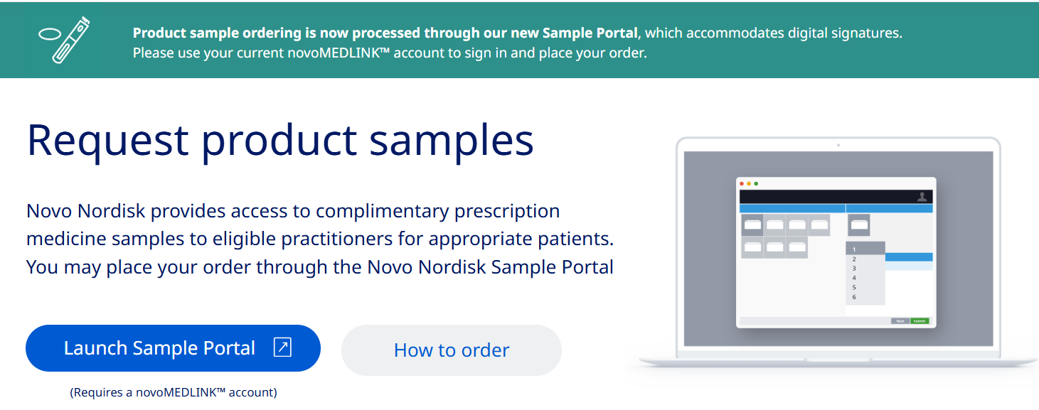
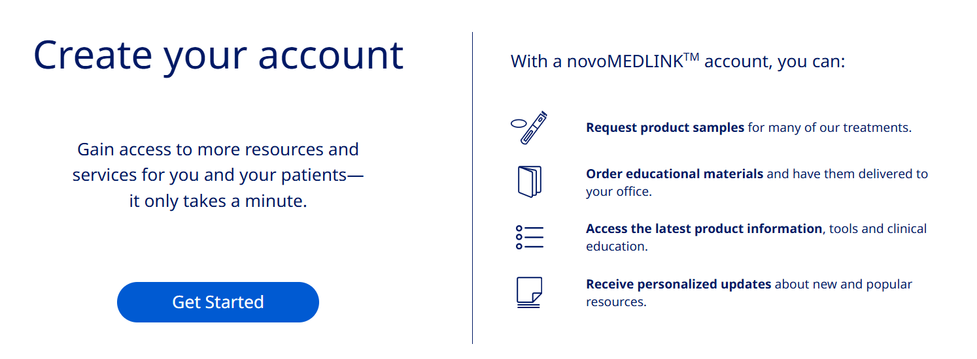
Novo Nordisk has “Sample Portal” to manage samples + Materials
Competitor Landscape

Slide 13
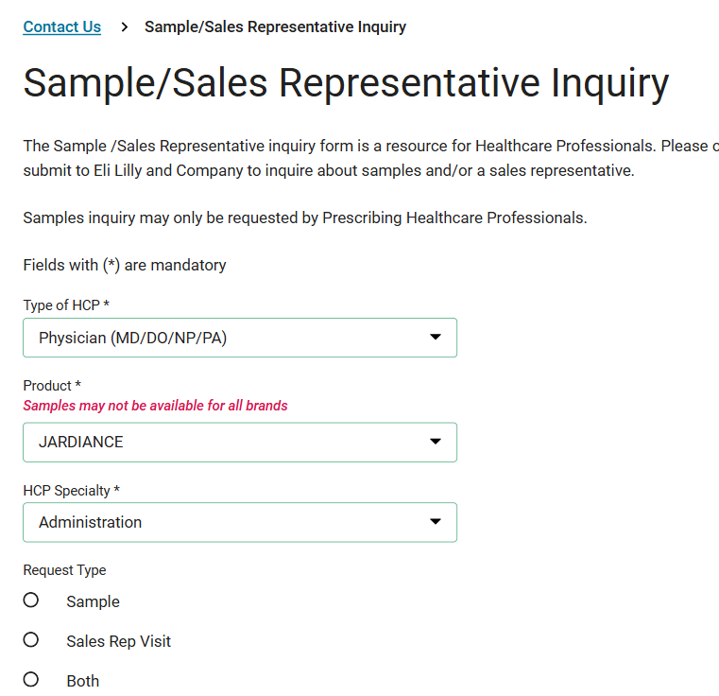
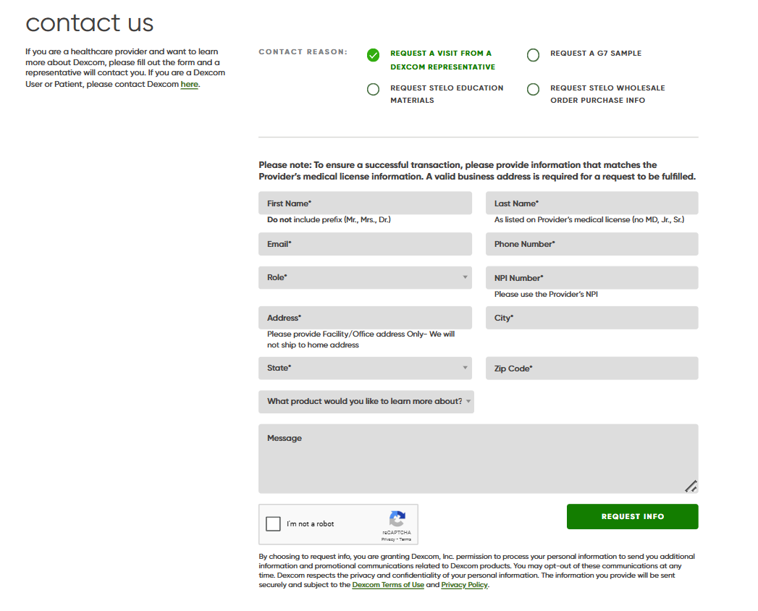
Eli Lily and Dexcom tie together CWR and Sample Requests
Competitor Landscape

Slide 14
Most HCPs distribute educational materials with samples, led by PCPs, who also share side-effect information more often than Endos.
Product samples
Materials Provided with Patient Samples
 | Total (A) | PCP (B) | Endo (C )
Instructions on how to use the product safely | 76% | 82%C | 62%
Patient educational materials specific to the product | 60% | 58% | 64%
Information on potential side effects | 57% | 62%C | 46%
Details on how to obtain a full prescription | 36% | 38% | 31%
Contact information for questions or concerns | 21% | 20% | 23%
Other | 0% | 0% | 0%
None of the above | 8% | 7% | 10%
Source: Total n=131; PCP n=92; Endo n=39
Q13:When you provide a sample to a patient, what materials do you usually give them?
Statistical testing at 90% significance
Notes:
Q13: When you provide a sample to a patient, what materials do you usually give them?

Slide 15
Customer Journey
PROJECT NEON

Slide 16
Project Carbon Current User Journey
Current Websampling Journey
CLOSED FORM
Email to resubmit with another email address
Fail
Ineligible Page OR
You’ve Already Requested Samples Page
DCR Process for certain HCPs
If doesn’t Fill out Docusign = Email Reminder
Success
HCP receives email or SMS with Unique Link
Prefilled Web Form. HCP submits & agrees TsCs
HCP receives Thank You Email
HCP Signs for Samples via Docusign
HCPs can go back to form to re-order
HCP receives samples
Update –
Query Eligibility Across entire CRM database (not just selected HCPs)
Update -
NEW: Dynamic Product Qty
NEW: Gov Agency Question
UPDATED: TsCs v2.0
Form Update -
NEW: Packing Slip Status
determine eligibility for re-ordering

Slide 17
Project Carbon Current User Journey
Current Websampling Journey
OPEN FORM
Email to resubmit with another email address
Ineligible Page OR
You’ve Already Requested Samples Page
Fail
DCR Process for certain HCPs
If doesn’t Fill out Docusign = Email Reminder
Success
HCP visits open form via media, website, tradeshow
Prefilled Web Form. HCP submits & agrees TsCs
HCP receives Thank You Email
HCP Signs for Samples via Docusign
HCPs can go back to form to re-order
HCP receives samples
HCP Inputs their NPI
Update –
Query Eligibility Across entire CRM database (not just selected HCPs)

Slide 18
Ideal - Project Neon User Journey
*DCR Process removed on slide for simplicity
Current Websampling Journey
Agnostic to Closed/Open Form
Email Confirming Delivery of new shipment
Ineligible Page OR
You’ve Already Requested Samples Page
If Doesn’t Sign
= Email Reminder
HCP visits form via email, sms, media etc.
Prefilled Web Form. HCP submits & agrees TsCs
HCP receives Thank You Email
HCP Signs for Samples via ???
HCPs receive samples on XXX Cadence
HCP receives samples
HCP Inputs their NPI
Update –
Opt-In to Auto Subscription
Continual loop Until:
HCP Reaches Limit X – 30
HCP Opts Out of Auto-shipment
HCP needs to sign new version of TsCs?
HCP No Longer Eligible (need to write)
Timed?

Slide 19
Scenario Planning & Requirement Building
PROJECT NEON

Slide 20
5minutes – Brainstorm additional scenarios not listed below that need to be addressed
SCENARIO PLANNING AND PRIORITIZATION
Red – High Impact
Yellow – Medium Impact
Grey – Low Impact
Rank | Scenario | Impact to CX | Impact to Biz | Effort | Pathforward
 | HCP Signs up for auto-shipment but also tries to place a re-order |  |  |  | MVP – Long Term -
 | HCP Opts Out of Autoshipment (Legal/OEC Must-Have)
 | HCP Opts Out of Autoshipment, but wants to opt-back in
 | HCP becomes “ineligible” halfway through the subscription model;
 | HCP enrolled in autoshipment & New Version of TsCs come out
 | ADC as a business runs out of samples
 | HCP is underutilizing Samples

Slide 21
Requirements: Opting into Auto-subscription
Requirement Building & Feasibility
“In order to have auto-shipment we will need…”
Steps | What needs to be True | Team | Effort | Notes
1 | Front End to display consent language approved by OEC on 3rd Step of Form
2 | Consent to be stored in ________
3 | Consent data to be passed from X to X on certain cadence

Slide 22
Requirements: Frequency & Cadence of Samples
Requirement Building & Feasibility
“In order to have samples be set on a regular cadence we will need…”
Steps | What needs to be True | Team | Effort | Notes
1
2
3

Slide 23
Requirements: Opting out of Auto-subscription
Requirement Building & Feasibility
“In order to have a successful opt out we will need…”
Steps | What needs to be True | Team | Effort | Notes
1
2
3

Slide 24
As a team, fill out best path forward (MVP vs Long Term)
SCENARIO PLANNING AND PRIORITIZATION
Red – High Impact
Yellow – Medium Impact
Grey – Low Impact
Rank | Scenario | Impact to CX | Impact to Biz | Effort | Pathforward
 | HCP Signs up for auto-shipment but also tries to place a re-order |  |  |  | MVP – Long Term -
 | HCP Opts Out of Autoshipment (Legal/OEC Must-Have)
 | HCP Opts Out of Autoshipment, but wants to opt-back in
 | HCP becomes “ineligible” halfway through the subscription model;
 | HCP enrolled in autoshipment & New Version of TsCs come out
 | ADC as a business runs out of samples
 | HCP is underutilizing Samples

Slide 25
Packing Slip Ideation
Requirement Building & Feasibility
“In order to have a frictionless packing-slip signage experience opt out we will need…”
HCP will receive FEDx Samples and sign for samples

